Slide 1
The Prosperity Master FUND
THE PROSPERITY MASTER FUND
EQUITIES
REAL ESTATE
DIGITAL ASSETS
PRIVATE EQUITY
INSURANCE INVESTMENTS
ENERGY

Slide 2

THE PROSPERITY MASTER FUND: OVERVIEW OF ASSET CLASSES:
THE PROSPERITY MASTER FUND
EQUITIES
REAL ESTATE
DIGITAL ASSETS
PRIVATE EQUITY
INSURANCE INVESTMENTS
ENERGY
Equities: Stocks, Bonds, & Traditional Markets
Real Estate: Income Producing Assets, Including Multifamily, Office, & Storage
Digital Assets: FinTech, Cryptocurrency, Blockchain, & Distributed Ledger Tech
Private Equity Investment Assets
Insurance Investment Assets: Life Settlements and Premium Finance
Energy: Maximization of Natural Resources & Alternative Technologies

Slide 3

The Prosperity Master Fund’s Growth Potential:
The Prosperity Master Fund provides access to unique investment opportunities that will maximize returns for investors in a variety of emerging and traditional multi-trillion-dollar asset classes, including Equities, Real Estate, Digital Assets, Insurance Investments, Energy, and Other Key Private Equity Investments.
Investors will have the opportunity to invest in the select investment categories above or in a basket of these asset classes together.
Our Fund will be available to funds, institutions, endowments, companies, private family offices, & other accredited investors. We will provide our investors with competitive returns and diversification at the frontier of emerging technologies and cutting-edge investment assets.

Slide 4
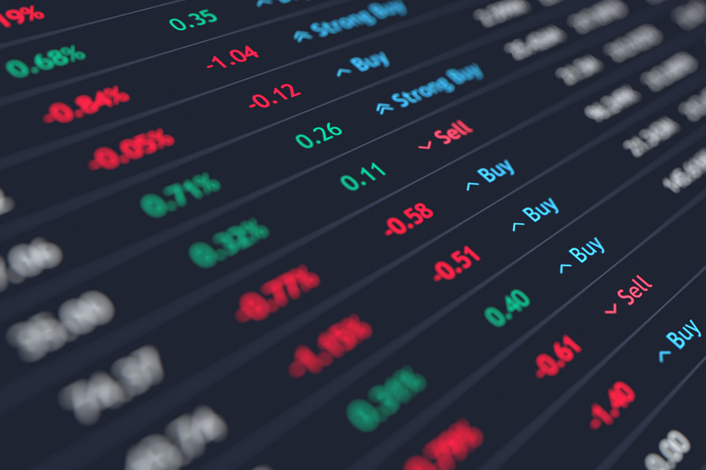
1. Equities & Traditional Assets:
Type: US Equities, ADRs, Western European Equities, Listed Options, Fixed Income, Preferred Securities, Cash
Method: rigorous quantitative and qualitative research, combined with replicable trading algorithms, to strive to generate consistent alpha.
Management constructs a long-focused equity portfolio with exposure to a variety of opportunities. Equity exposure is complimented by our proprietary Variance Swap Process, which generates asymmetrical cash flow throughout market conditions and ideally accelerates the growth of the equity portfolio. Our guiding philosophy is that risk parity is most impactful when it consists of exposure to different investment processes, not just asset classes.
Since 2018, management has delivered consistent returns that exceed the risk adjusted returns of our equity benchmarks.
Historical Record:
Annualized Return Since 2018: 16.32%
Risk Standard Deviation: 4.41%
This Photo by Unknown Author is licensed under CC BY-ND

Slide 5

2. Real estate
TYPE:
Income Producing Assets
SECTOR:
Multifamily, Office, Luxury & Storage
Our Managers select key opportunities for income producing real estate, primarily in U.S. Markets, with competitive value add strategies and management, That provide appreciation and consistent Positive cash flow.
We invest in key Markets that provide tax advantages.
Real estate Assets in our portfolio have been featured in the Wall street journal and a Netflix TV real estate series.
Historical Record:
Roi: 15%+ Annualized Returns Since 2018
This Photo by Unknown Author is licensed under CC BY

Slide 6

3. Digital Assets:
> Fintech – Cutting edge tech at the center of business, Payments, and technology
> Cryptocurrencies, Blockchain, Distributed Ledger Technology, Mining & Emerging at the center of the future financial infrastructure, including iso20022 compliant frameworks.
Selection: high liquidity assets in the top 100 Market cap, with the opportunity for Low-Caps , as well. Iso2022 Standardized frameworks, PoS, POW, & Other consensus mechanisms may be included, As well.
Timeline:
Projected 3-5 Year Investment Horizon
Return Potential:
Projected returns in excess of 100+% ROI, With Double digit baseline returns

Slide 7

4. PRIVATE EQUITY
> Basket of select Private equity and key investment opportunities ranging from a variety of industries, Including Government defense contracting, PHARMA, & Other private industry
> Leveraging our key industry contacts, we May access various mergers and acquisition deals in both middle and large markets.
> Projected Timeline: 5 Year Horizon
> Projected Returns: 50-100%+ IRR
This Photo by Unknown Author is licensed under CC BY

Slide 8

5. Insurance assets
> Life Settlements:
METHOD: policyholders who no longer want, need, or can continue to afford the high cost of their life insurance premiums, can sell all, or even a portion of their life insurance policy to a 3rd party, for more than the policy cash surrender value back to the insurance company, but less than the total benefit. The policy is then acquired by the purchaser, who continues to fund the remaining premiums, and thereby collects the total life insurance policy benefits afterward. thus, the FUND receives a non-market correlated asset for their portfolio, that can achieve double-digit returns, while the policyholder receives the much-needed capital for their families and their businesses.
Selection: A Rated Policies, With 65+ Yrs. Of Age, Favorable LE Reports via industry leading actuarial Firms.
> Premium finance:
Premium financing is the lending of funds to a person or company to cover the cost of a Life insurance premium.
To finance a premium, the individual or company requesting insurance must sign a premium finance agreement. The premium finance company then pays the insurance premium and bills the individual or company the required interest payment as revenue.
Historical RECORD:
12%+ Returns in prior funds such as eternity fund.
This Photo by Unknown Author is licensed under CC BY

Slide 9

6. Energy
> Maximization of Natural Resources & Alternative Technologies, Including Gas, Solar, Wind, & Nuclear Sources.
> Alterative sources of ENERGY with a focus on reducing the carbon footprint in line with current ESG standards.
> May Include PROFIT SHARING ARRANGEMENTS FOR Cryptocurrency mining via alternative energy Resources and other methods of production.
> Return Potential may be even greater than traditional energy investments due to potential profit-sharing arrangements on energy usage and electronic equipment.
This Photo by Unknown Author is licensed under CC BY-SA-NC

Slide 10


Our INVESTMENT MANAGEMENT MODEL:
> 2% Management Fee
> 20% of Profit Returns

Slide 11
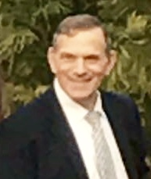
Yale Fishman, J.D.
Senior Fund Manager
Yale Fishman has over 30 years of experience leading and advising funds, institutions, & high-net-worth investors on tax-advantaged investment structures and sophisticated estate & income tax vehicles. CEO’s and Fortune 500 executives from the nation's most prestigious firms seek his expertise on the structuring of their business tax strategies, and he has counseled clients on transactions in excess of $1 Billion dollars. Since 2005, he managed over $1.2 Billion dollars in assets, where he earned major returns for investors. Fishman has broken records as a successful real estate developer via his real estate investment company, Hamptons Luxury Estates. Now, Fishman brings his wealth of experience and proven success to The Prosperity Master Fund’s renowned management team. Mr. Fishman received his BA in Business Economics from Touro College and his Law Degree from Seton Hall Law School in the USA.

Slide 12
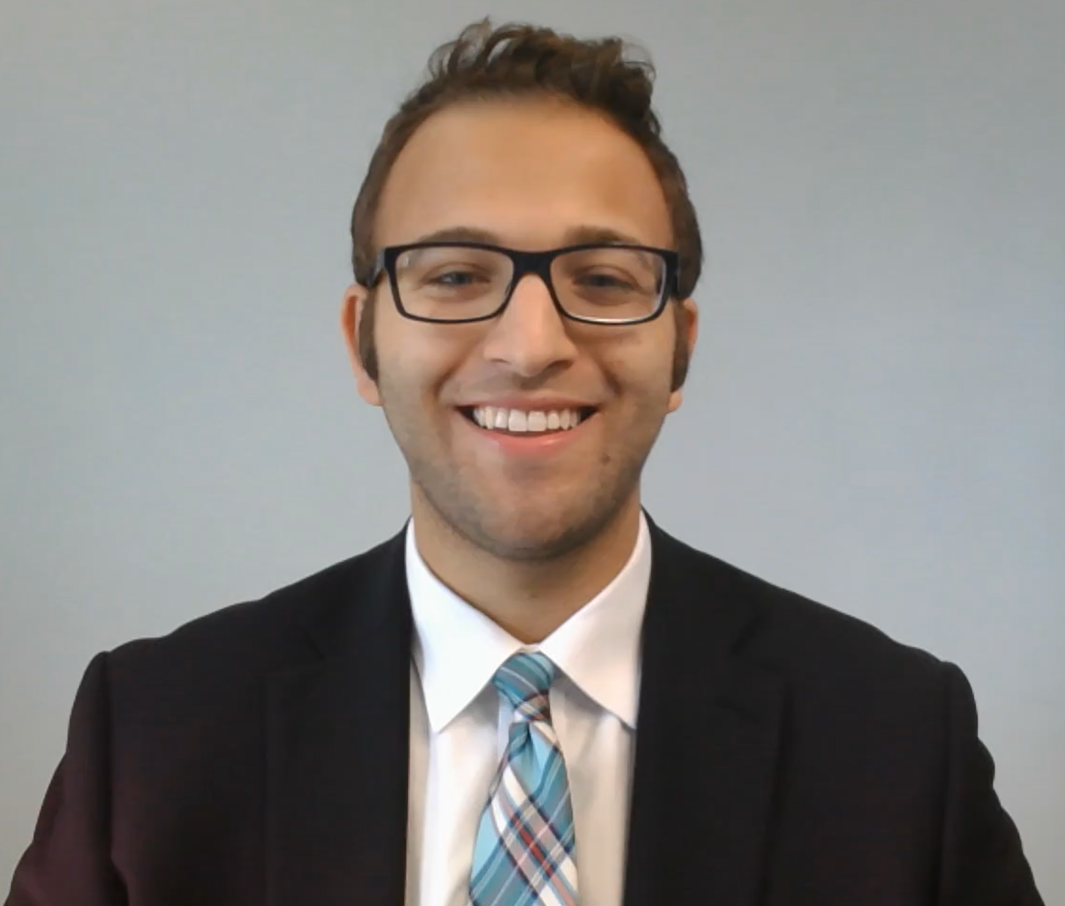
Ariel Fishman, MBA; LA, LB, LSB
Digital Assets, Insurance, Real Estate, & P.E.; Manager
Ariel Fishman served as an MBA Merit Scholar at Georgetown University’s McDonough School of Business in Washington D.C. At Georgetown, Fishman served as a member of the Graduate Investment Fund, the Entrepreneurship & Venture Capital Group, & the Real Estate Society among other university organizations. Fishman led his startup team to victory and won 1st place in the Startup Factory Competition at Georgetown University in, 1st place in the Wildcard Entrepreneurship Challenge, & was a University-wide Finalist in the Leonsis Family Entrepreneurship Competition. Previously, Fishman attended Columbia University’s Leadership in Law program in NYC and graduated with bachelor’s degrees from both NIRC & the University of the State of NY and MBA from Georgetown University. Additionally, Fishman represented the USA at the RoboCup Robotics Competition in Europe. Fishman served as co-founder of the Kindness Initiative and is a member of the National Ethics Association. Fishman specializes in digital assets, fintech, and cryptocurrency as well as insurance and real estate investment opportunities across the globe. Fishman has been featured in various business and tech-focused publications including Biz Journal, DC Inno, & Technically DC.

Slide 13
David Reidy is the founder and principal of JCAM, an asset management firm specializing in quantitative equity, derivative, and tail risk strategies established in 2019. David served as the Chief Investment Officer of The Parkridge Group and lead portfolio manager for the Dynamic Alpha Strategy. Since co-establishing the Parkridge Group as an investment adviser. in 2012, David has led the development and implementation of a multi asset class approach to alpha generation and risk management for retail and institutional investors. David has spent over 15 years in the finance industry, both on the sell and buy side. He is a board leader for an educational nonprofit in Maryland and is involved in national political advocacy on behalf of causes and constituencies he’s passionate about. He lives with his family in suburban Baltimore, MD.
DAVID REIDY, Principal, Parkridge Group & JCAM Dynamic Alpha
Equities, Assets, & markets; Manager

Slide 14
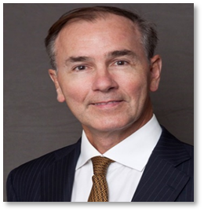
Thomas S. Gallagher, Esq.
General Counsel & Chief Compliance Officer
Thomas S. Gallagher, Esq. focuses his practice on the representation of U.S. and offshore hedge, private equity and specialty finance funds, fintech and technology companies in corporate, securities and regulatory matters. He has represented a wide-range of private equity and hedge funds, both domestic and off-shore, engaged in, among other things, equity and debt investments, commercial and consumer lending, credit card, international trade finance and other receivable investments, equipment leasing, insurance products, commercial and residential real estate investments, energy (solar and other green energy investments as well as traditional oil and gas investment funds), and intangible assets, such as Intellectual property assets.
During the past ten years, Mr. Gallagher has been a partner in the New York office of several large prestigious national and international law firms, Dorsey & Whitney LLP, Pepper Hamilton LLP and Baker Hostetler LLP.
In addition to being the General Counsel & Chief Compliance officer, Mr. Gallagher currently serves as a member on the Board of an international technology and marketing company involved in 5G and IoT as well as cryptocurrency and blockchain. He is the principal of a financial and legal advisory firm and also serves as outside legal counsel and advisor to a diverse group of private equity companies and businesses involved in FinTech/consumer lending, oil and gas development and production, and machine learning.
Mr. Gallagher received his B.A. in political science from Penn State (summa cum laude) and his J.D. Degree from George Washington University’s national law center. He is a member of the New York, D.C., and Maryland bars.

Slide 15
Contact Us
The Prosperity Master Fund
Equities. Real Estate. Digital Assets. Private Equity. Insurance. Energy.
Fund Name: Prosperity Fund, LLC
Fund Manager: Prosperity Fund Management, LLC
Email: ProsperityMasterFund@gmail.com
Office: 516 374 0350
Executive Team:
Yale Fishman, J.D.; Senior Fund Manager
Ariel Fishman, MBA; LA, LB, LSB; Digital Assets, Insurance, Real Estate, & Private Equity; Manager
David Riedy, Parkridge Group & JCAM Dynamic Alpha Strategy; Equities, Assets, & Markets; Manager
Thomas S. Gallagher, ESQ.; General Counsel; Chief Compliance Officer

Slide 16
DISCLAIMER:
This Presentation has been prepared solely for information purposes. It is not an offer to sell or a solicitation of an offer to buy securities. The securities described in this Presentation have not been registered under any federal or state securities laws or examined or passed upon by the Securities and Exchange Commission or any state regulatory authority. There are various risks associated with this & similar investments. Anyone interested in this investment opportunity should consult with their own independent financial, tax, legal, or other advisors before committing to an investment. No such advice is being provided herein. This Presentation & the investment described herein are subject to change without notification. The definitive terms of such investment will only be set forth in an Offering Memorandum & the accompanying investment documents.

